Slide 1
World Power Consumption
BY-
Lakshmi Lavanya Javvadi
U85351468

Slide 2
Data
Nuclear energy dataset, Fossil fuel energy dataset, and Renewable energy dataset - Data consumption from 1980 to 2020 is included.
URL's
https://ourworldindata.org/nuclear-energy
https://ourworldindata.org/fossil-fuels
https://ourworldindata.org/renewable-energy

Slide 3
Research Questions
Different countries installed capacities for different types of renewable energy.
Compare the energy or power consumed by all countries or continents with respect to the GDP and Population
Evaluate the various energy sources, such as nuclear power, renewable sources, and fossil fuels.

Slide 4
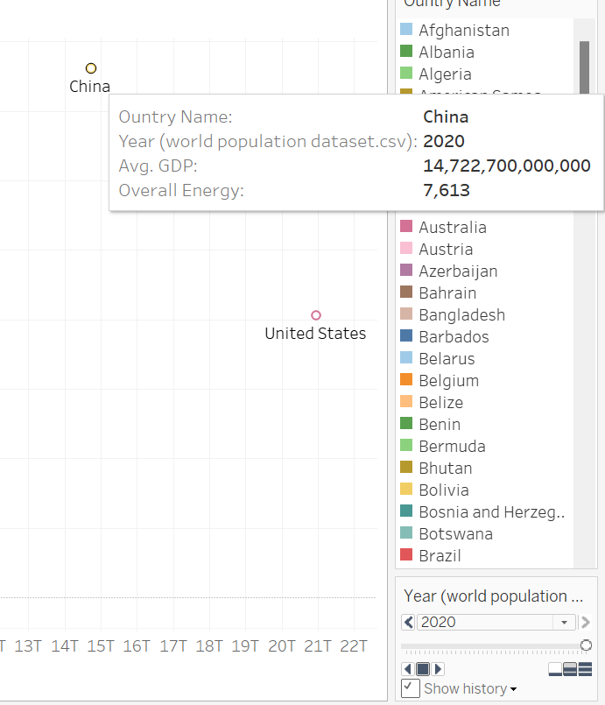
Energy consumed w.r.t GDP
A modern economy cannot run without the consumption of energy, which is needed for many different tasks like production, manufacturing, and transportation. China's high GDP energy consumption reflects the country's rapid industrialization and urbanization over the past few decades.
According to a computation of the Gross Domestic Product (GDP) for the amount of energy consumed by various countries in 2020, China utilized an average of 7,613 billion KWH.

Slide 5
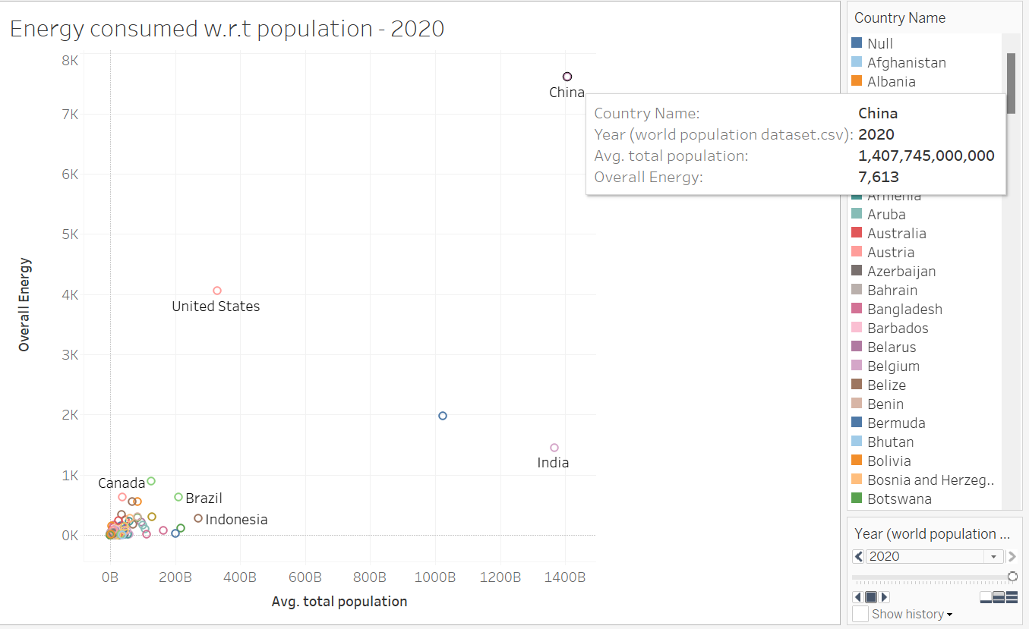
Energy consumed w.r.t Population
China is the world's greatest energy consumer, needing more than 4,700 million tons of oil equivalent (Mtoe) in 2020, according to the International Energy Agency (IEA). About 24% of the world's energy is consumed in this way. The main factors influencing China's energy usage over the past few decades have been the nation's fast economic growth and urbanization.

Slide 6
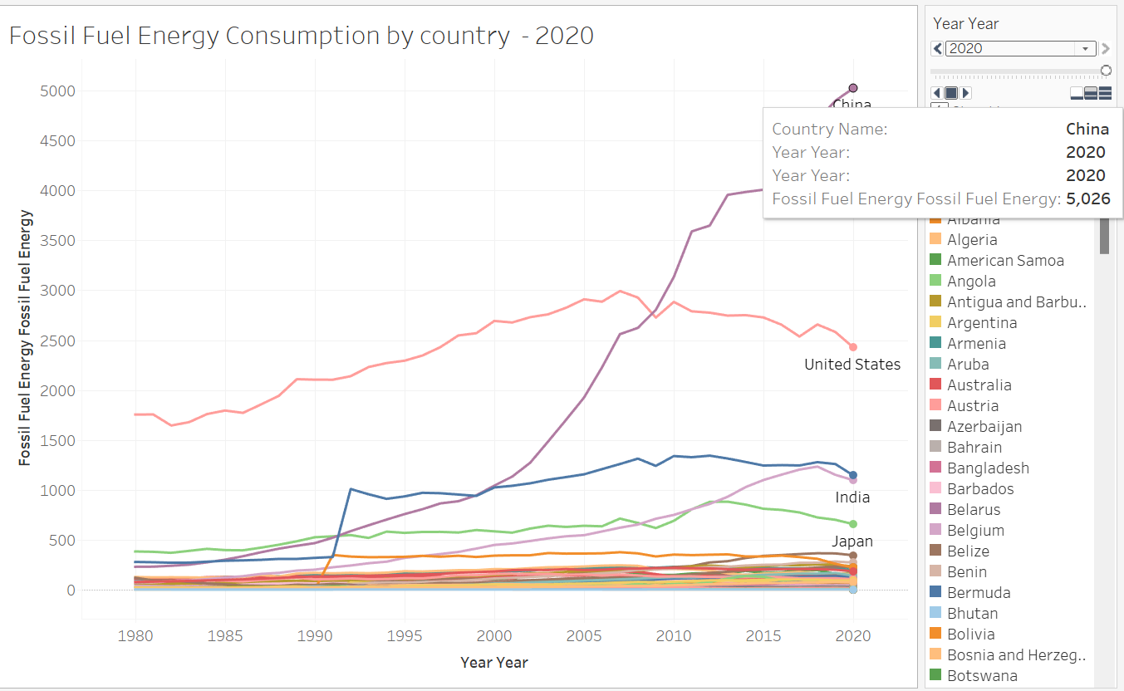
Fossil Fuel Energy Consumption by country-2020
From 1980 through 2020, we can observe how much fossil fuel each nation used.
The USA initially consumed the most fossil fuel-based energy, totaling 1754 billion KWH; but, by 2020, China had surpassed the USA as the nation consuming the most fossil fuel-based energy, totaling 5026 billion KWH.

Slide 7
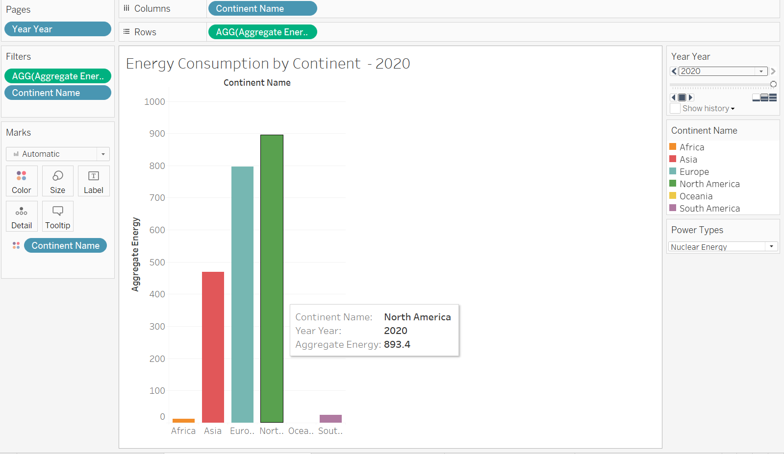
Nuclear Energy Consumption by Continent
In 1980, North America consumed the most nuclear energy per continent, followed by Europe and Asia, as seen in the graph. However, by 2020, North American consumption had risen on a par with that of Europe and Asia.

Slide 8
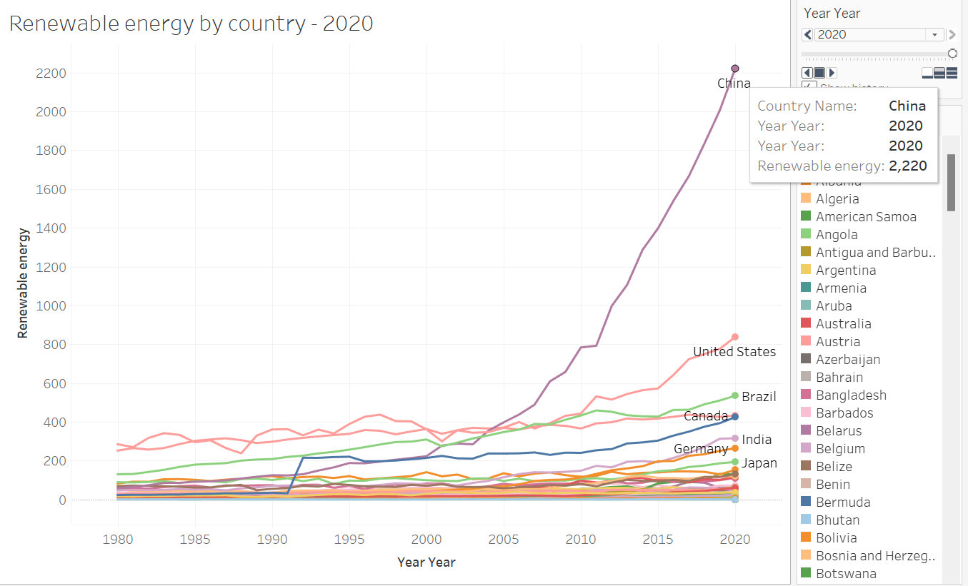
Renewable Energy Consumption by Country- 2020
According to the map, the United States consumed the most renewable energy in 1980 with a value of 285 billion kwh. The United States was one of the most industrialized countries at the time, and as a result, there was a high demand for energy to support its developing economy. Canada came in second with a value of 252 billion kwh, which is also very big when compared to other countries. Other countries on the map have significantly lower levels of renewable energy consumption.
China, with 2,200 billion KWH of renewable energy consumption in 2020, is at the top.

Slide 9
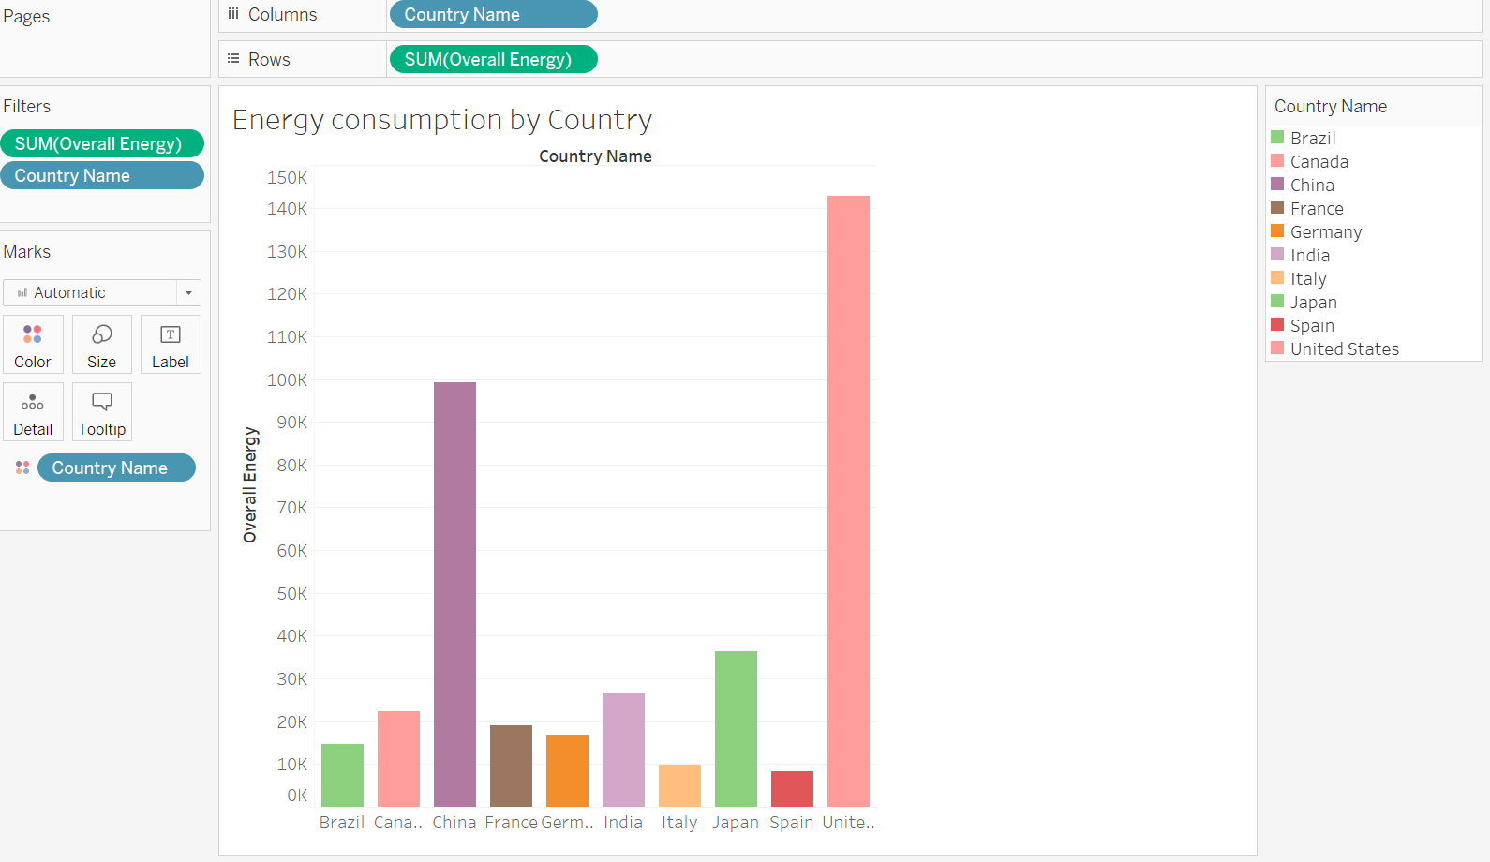
Energy Consumption by Country
The graph displays each country's overall energy consumption from 1980 to 2020 using a color-coded scale. According to the graph, the United States has been the world's largest energy consumer over the preceding 40 years. China has risen to become the second-largest energy consumer in the world during the previous few decades. The country's energy usage has significantly increased since the early 2000s along with its brisk industrialisation and economic growth.

Slide 10
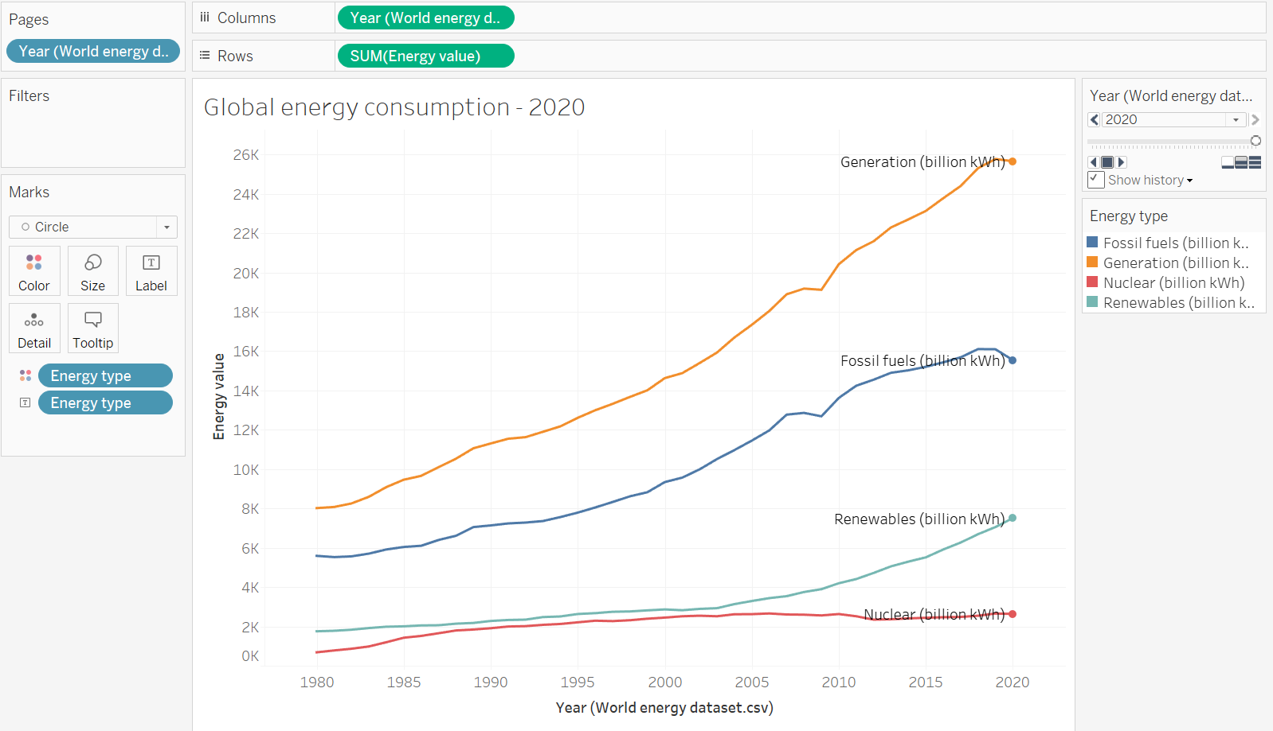
Global Energy Consumption-2020
Renewable energy sources generated over 20% of all energy. According to the graph, there was not much variation in the production of renewable energy up until 2003. However, after 2003, the production of renewable energy rose exponentially.
According to the graph, nuclear energy generated around 5% of total energy over the course of the 40-year period. Nuclear energy has been a reliable source of energy that is consistent and reliable.

Slide 11
Conclusion
The maps generally show that, despite some countries making far more progress than others, the usage of renewable energy has increased significantly during the past few decades in a large number of countries. It is interesting that China will dominate the usage of renewable energy in 2020, which shows that the country is moving forward rapidly toward a more sustainable future.
Over the course of the 40-year period, fossil fuels accounted for a sizable portion—roughly 75%—of the total energy produced. This illustrates the significant role that fossil fuels play in meeting global energy demands. Nevertheless, the overall share of energy from fossil fuels has declined recently. According to the graph, there was not much variation in the production of renewable energy up until 2003.

Slide 12
Future Questions
hat reasons are anticipated to drive these changes in energy consumption rates, and how are they predicted to change in the future?
What are the effects of global energy consumption on the environment, and how can they be reduced?
How does energy use impact economic expansion, and can the creation of clean energy act as a spur for it?

Slide 13

Thankyou

